Slide 1


CoolSim & Delorean
汇报人：巢玲威 薛江莹
汇报日期：2024.3.19

Slide 2
01
CoolSim
CONTENTS
目录
02
Delorean

Slide 3
01
CoolSim
CoolSim: Statistical Techniques to Replace Cache Warming with Efficient, Virtualized Profiling

Slide 4

Motivation
detailed simulation
Gem5，QUME，准确度高
速度慢，比本机慢5个数量级
SimPoint，SMARTS， detailed模拟1%指令
快进耗时
Sample simulation
Use checkpoints
快速restore架构状态
无法应对软件变化（软硬件协同）
VFF
FSA，不需要checkpoints
functional warming占据大量时间
Lager cache，warm时间越长
statistical cache model
消除了functional warming

Slide 5
Contributions
1
proposes CoolSim to eliminate cache warming
with fast, virtualized fast-forwarding and statistical cache modeling
combines and enhances ideas from WarmSim and FSA
2
contributions
proposes a new MRI collection mechanism that runs on top of the virtualized fast-forwarding mode of gem5
improve on WarmSim’s cache modeling methodology(sparse MRI，lukewarm cache and No-blocking cache)
leverage technologies from FSA and WarmSim and propose an integrated online statistical simulation framework

Slide 6
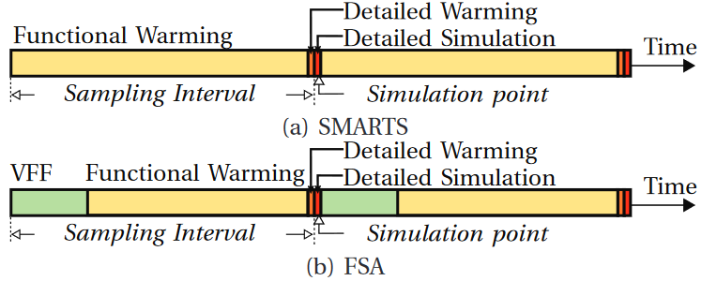
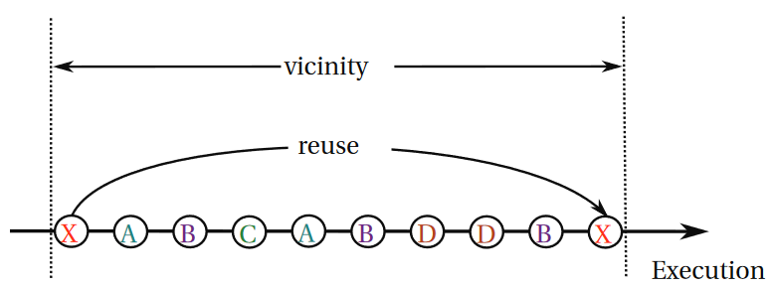
Background
1
Virtualized Simulation Fast-Forwarding
hardware virtualization to advance simulation at near-native speed
substitute slow functional fast-forwarding (FF)
2
Statistical Cache Modeling
MRI：memory reuse information
memory stride
reuse distance
stack distance
Vicinity

Slide 7
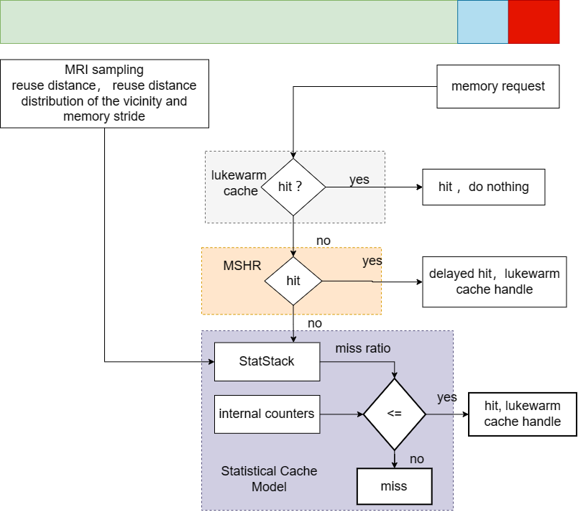
CoolSim
1
MRI Sampling
samples random memory instructions
Reuse distance
Memory stride
2
The Lukewarm Cache
a cache with partially populated state
hit → do nothing
miss → insufficient warming or cache capacity
3
MSHR
miss status holding registers
tracks outstanding requests that missed and are waiting for data from the memory

Slide 8
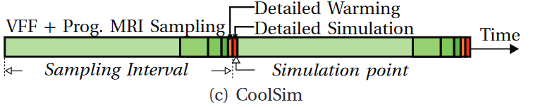
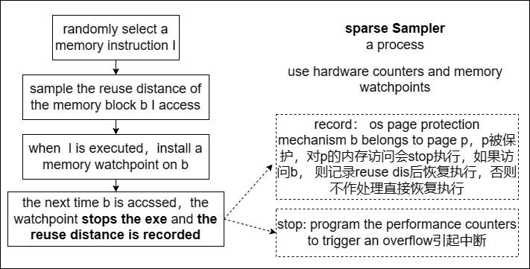
MRI Sampling
1
Random sampling
the hardware performance counters to overflow
triggers an interrupt that stops the execution
measure the load and store
2
Measuring Reuse Distances
The selected instruction I， cache block b
Install a watchpoint on b (software）
protect the relevant memory page p
3
Measuring Instruction-Relative Strides
places a breakpoint(software interrupt) on I
records the memory stride between the two consecutive executions of the instruction I

Slide 9
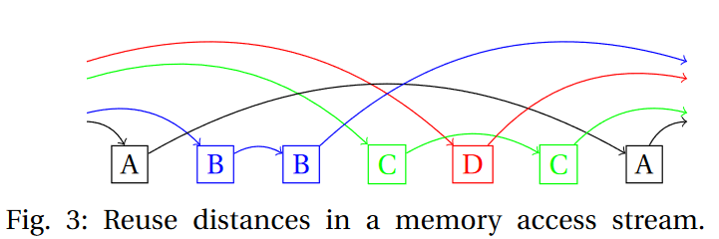
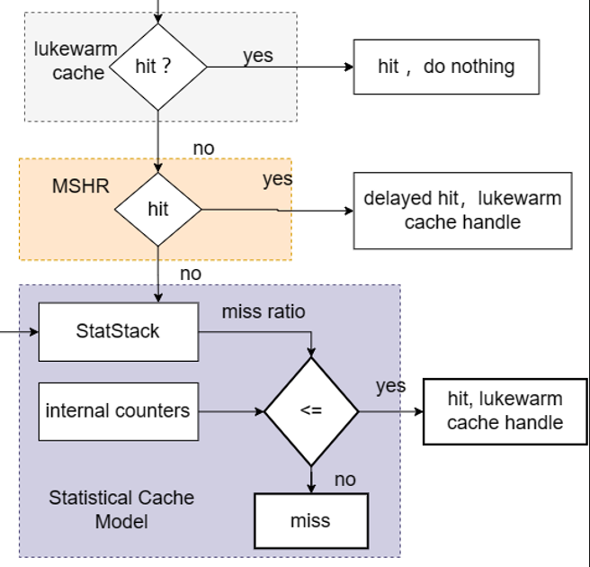
Cache Model
1
Non-Blocking Caches
serve multiple outstanding memory requests
hit in lukewarm cache → do nothing
miss but hit in MSHR → delayed hit
miss both → cache model handle
2
StatStack
estimates the stack distance
3
Statistical Cache Model
estimate the miss ratio of the instruction I
Compare with internal counters
<= a hit ，fetch the block，internal hit counters +
else a miss，internal miss counters +

Slide 10
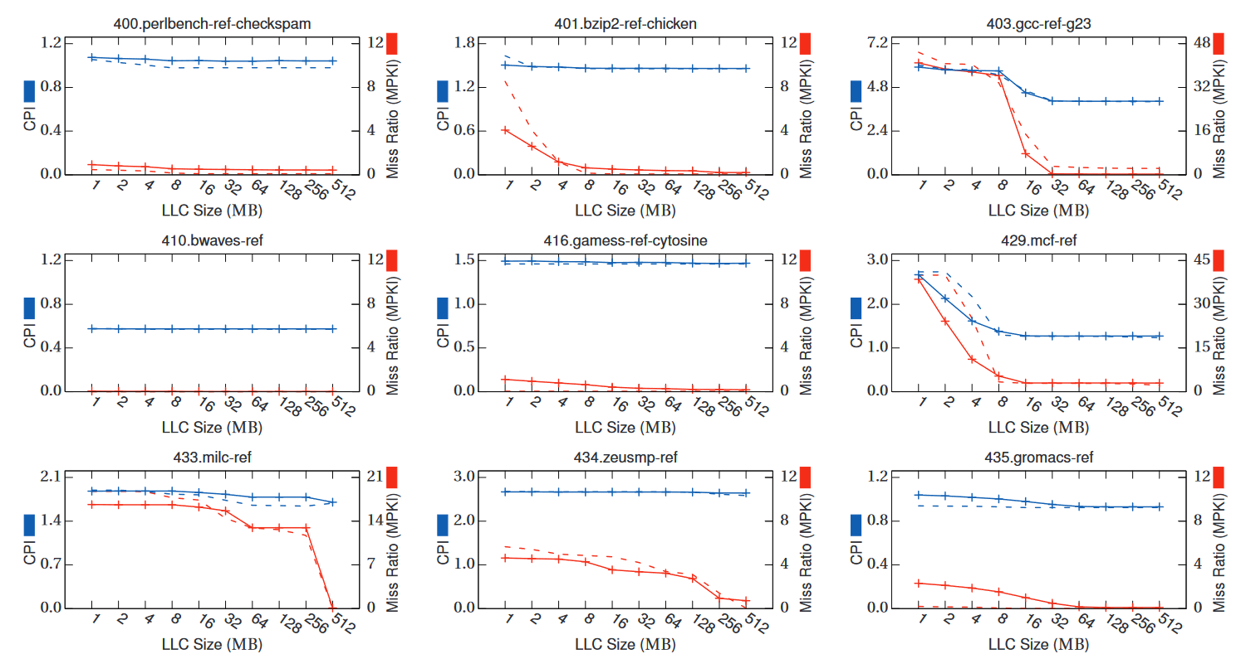
EVALUATION——Accuracy

Slide 11
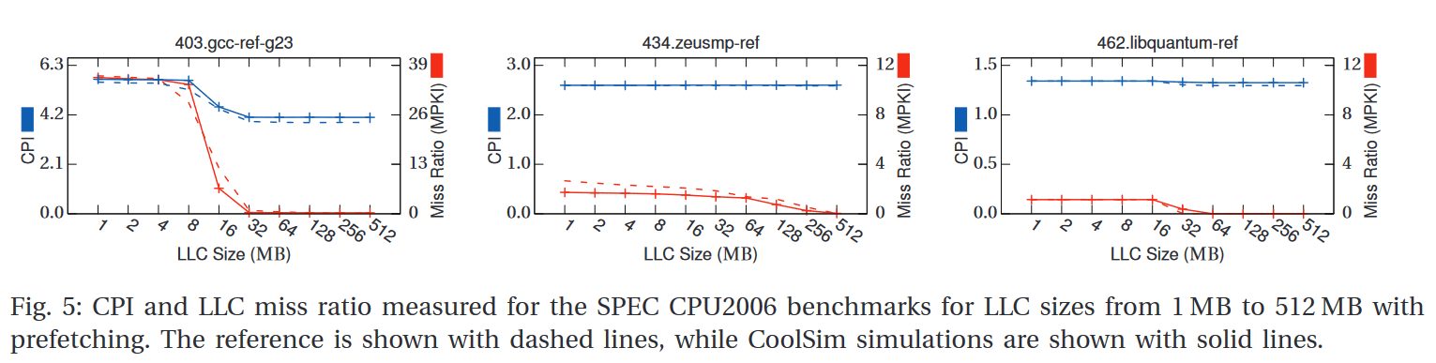
EVALUATION——Accuracy-Prefetching
models the performance of the SPEC CPU2006 benchmarks with an average error of 4.77 %

Slide 12
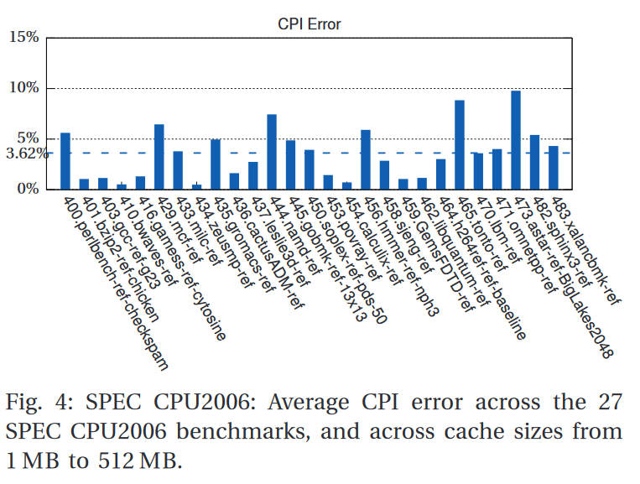
EVALUATION——Accuracy & Performance
accuracy
3.62 % error on average
performance
CoolSim’s average performance is 17.23 MIPS
19x speedup over the reference which simulates at 0.89 MIPS

Slide 13
02
Delorean: Virtualized Directed Profiling forCache Modeling in Sampled Simulation

Slide 14
Delorean---Background
1
Motivation
采样---受到架构状态影响
检查点---equires that the simulated system uses the same inputs, binaries and operating system as the checkpointed system
2
目标
enables both flexibility and accuracy by quickly generating a targeted cache model for the next detailed region on the fly without the need for up-front simulation or modeling

Slide 15
Delorean---METHODOLOGY
VFF + statistical cache modeling
Phase A: The simulator state is quickly checkpointed (using copy-on-write techniques) and VFF is used to advance execution to the next simulation point. Detailed simulation is then used to record the small number of cachelines accessed during that simulation point. These are the key cachelines.
Phase B: The execution is then restarted at the checkpoint to record the last use of each key cacheline just before the simulation point. Our method, Virtualized Direct Profiling (VDP), efficiently collects the exact reuse distance for each key cacheline.
Phase C: Finally, at the simulation point, we use detailed simulation and the exact reuse distance for each of its memory accesses as obtained in Phase B to estimate its cache behavior using a state-of-the-art statistical cache modeling technique.

Slide 16
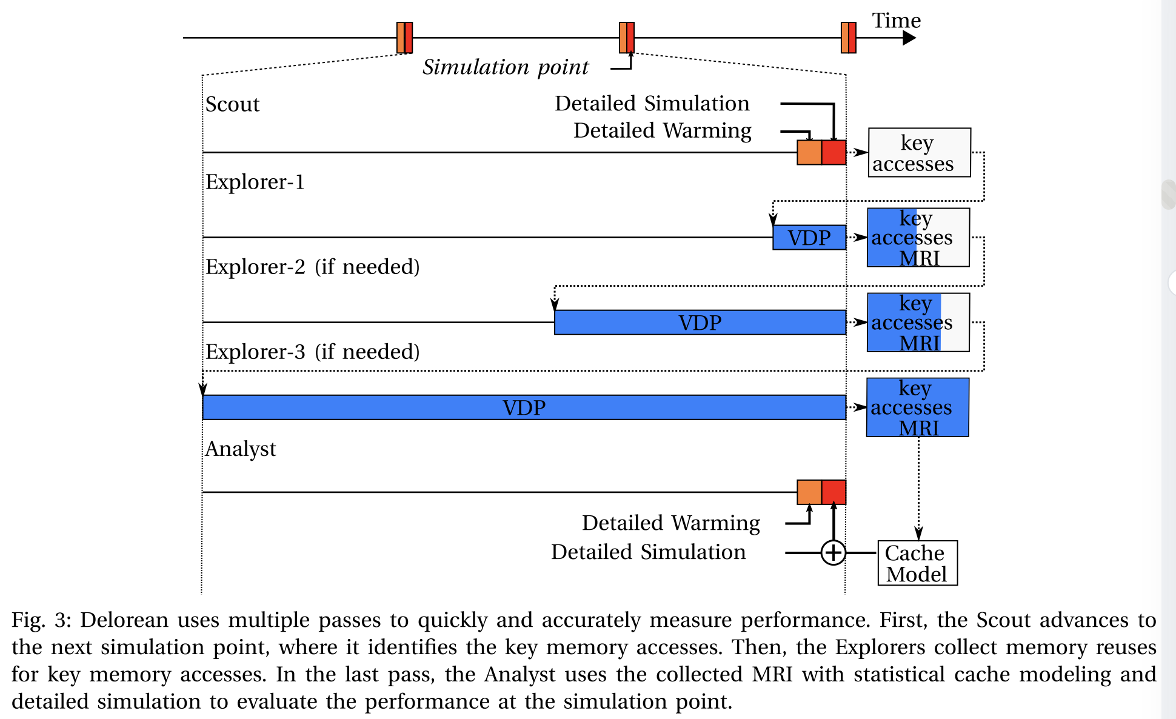
Delorean---METHODOLOGY
A. Directed MRI Profiling

Slide 17
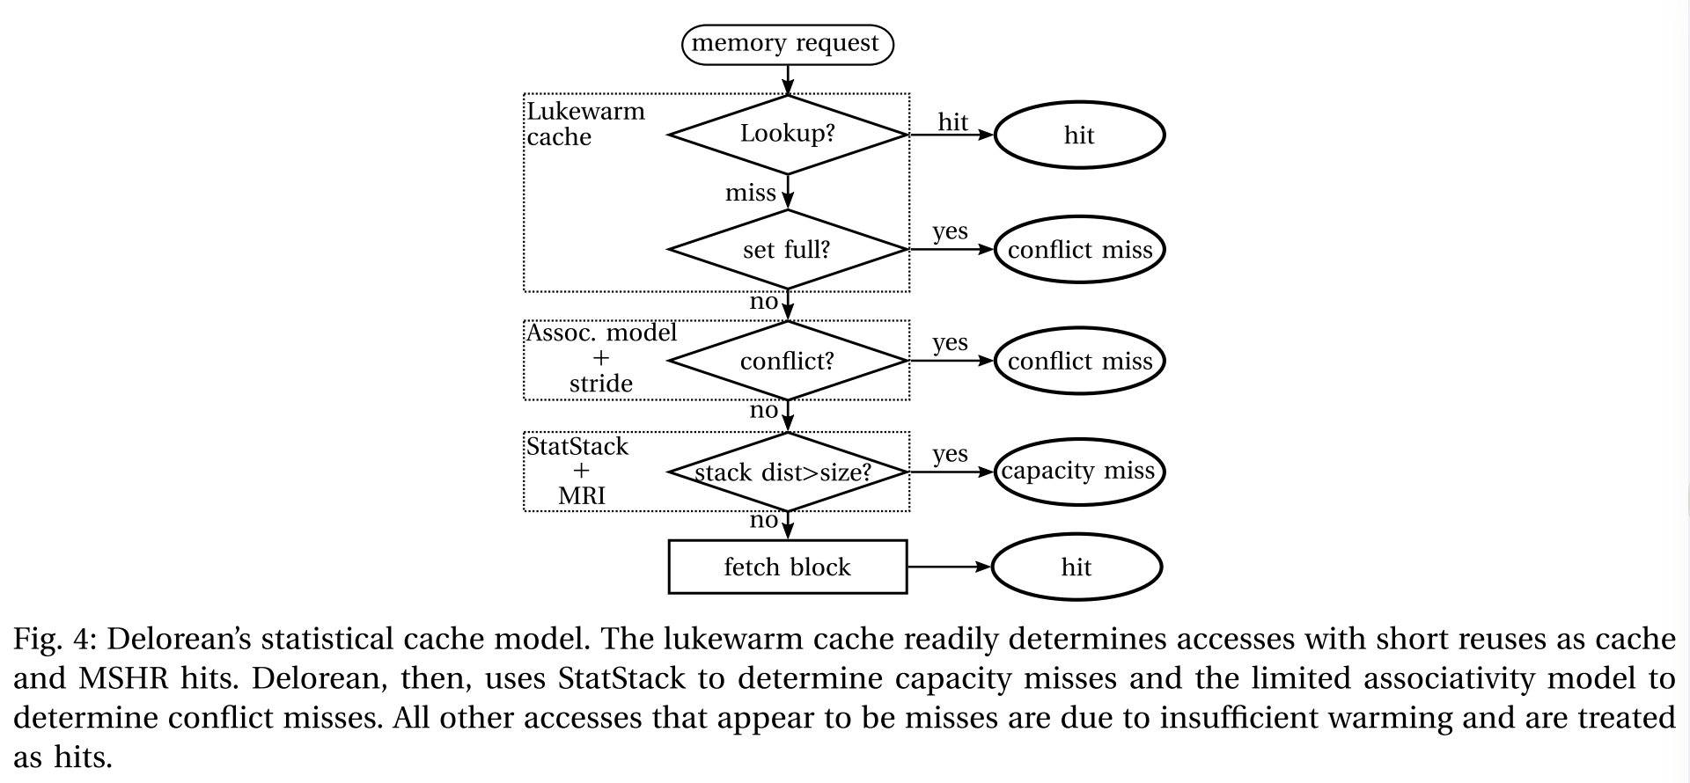
Delorean---METHODOLOGY
B. Statistical Cache Modeling
detailed warming(W)
只有一小部分cache被预热
Lukewarm cache平均命中率88%
Lukewarm + MSHR = 95%
the Analyst has to determine
the warming misses and
handle them as cache hits (Figure 4).
Requests that miss both
in the cache and the MSHRs
are the key accesses
as recorded by the Scout.
Notes:
当具有均匀访问模式和大步长的指令在较小的缓存中无法容纳其完整的工作集时，它们被视为冲突缺失。这是因为其他指令可能已经占据了较小缓存中的某些位置，导致这些指令无法将其完整的工作集放入缓存中，从而导致缺失。

Slide 18
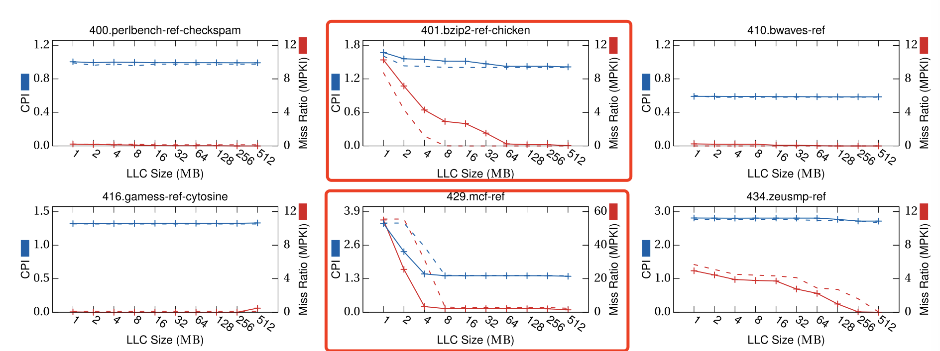
Delorean---EVALUATION
准确性

Slide 19
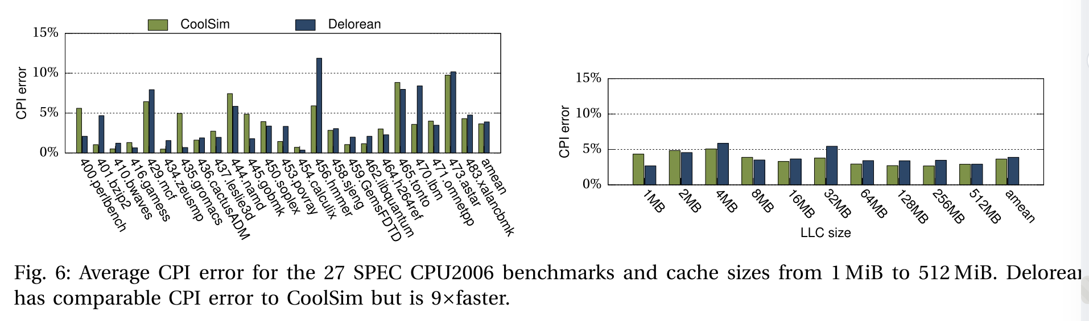
Delorean---EVALUATION
准确性

Slide 20
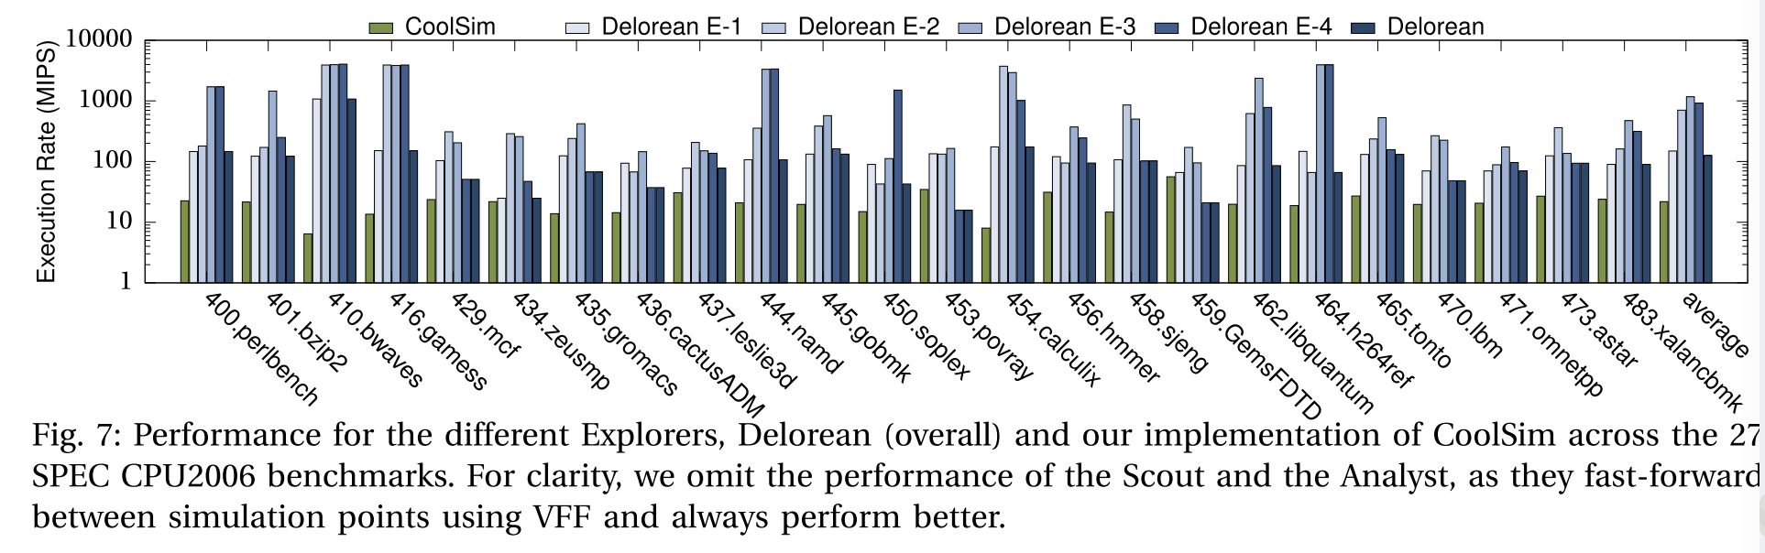
Delorean---EVALUATION
性能

Slide 21
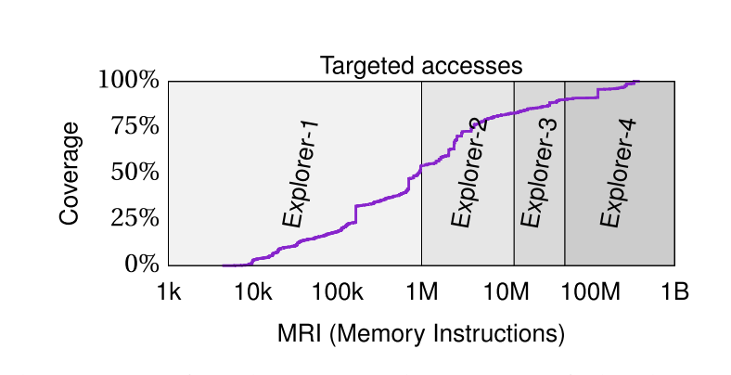
Delorean---EVALUATION
性能

Slide 22
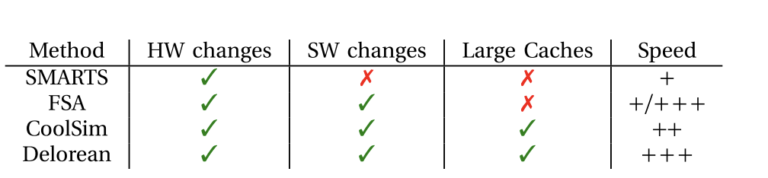
Delorean---EVALUATION
对比

